Slide 1
What do you think are the essential elements of a fairy tale? You may use a personal favorite to provide examples of these elements.
Journal #1

Slide 2
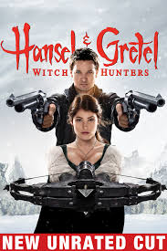
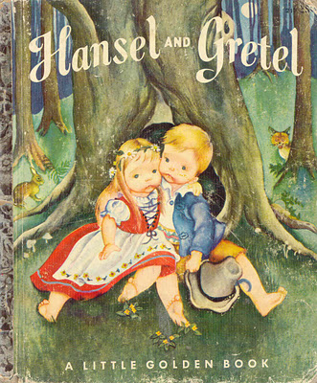
Then and Now
http://youtu.be/TB11JlyjmkE

Slide 3
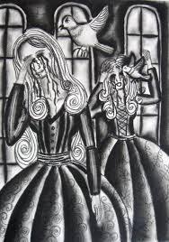
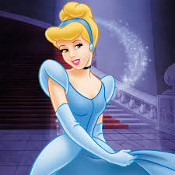
Introduction to Fairy Tales

Slide 4
Key Terms
Allegory- a literary work with more than one level of meaning. Allows a writer to tell a story about a literal character and make a moral, religious, or political point (Avatar)
Allusion- a reference to a well-known person, place, event, literary work, or work of art
Archetype- a detail, image or character type that occurs frequently in literature and myth and is thought to appeal in a universal way to the unconscious and to evoke a response (ex. The hero: rescuer or champion; the witch: dangerous)
Fable- a brief story usually with animal characters, that teaches a lesson, or moral (Aesop’s Fables)
Fantasy- a highly imaginative writing that contains elements not found in real life. The writer presents improbable characters, places, and events, often ones involving magic or the supernatural

Slide 5
Key Terms Continued
Folklore – Includes the stories, legends, myths, ballads, riddles, sayings, and other traditions handed down orally by ordinary people. It reveals a great deal about the culture in which it originates (Robin Hood)
Folk tale- A story composed orally and then passed from person to person by word of mouth. Originates among people who could not read and write, and were passed from generation to generation (Little Red Riding Hood)
Legend- a widely told story about he past, one that may or may not have a foundation in fact. Often reflects a peoples identity or cultural values. More historical truth and less supernatural
Moral – a lesson taught by a literary work; they present morals that are directly stated.
Myth- A fictional tale that explains the actions of gods or heroes or the causes of natural phenomena
Oral tradition- the passing of songs, stories, and poems from generation to generation by word of mouth

Slide 6
Background
Existed for thousands of years
  No exact ‘origins’
  Told orally
  Not written for kids
  An element of marvel/magic
  More common than you might think!
  Sensationalized by Disney
  TV shows: Grimm; Once Upon a Time

Slide 7
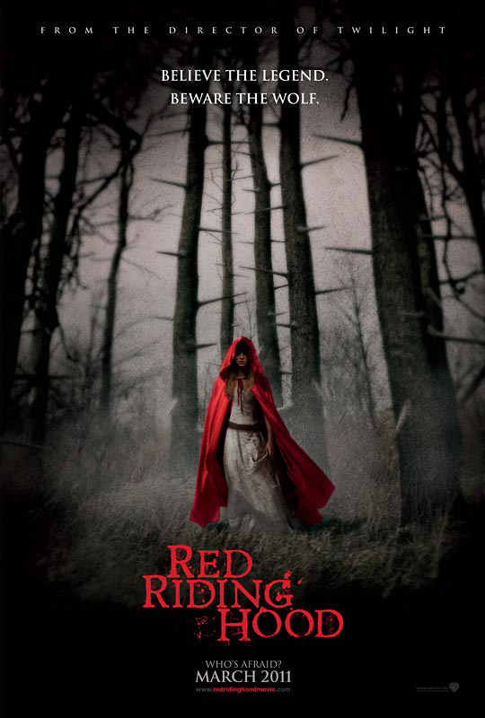
Charles Perrault
French author
Born January 1628; Died May 1703
Helped revolutionize fairy tales.
Incorporated his surrounding scenery in his work
Famous for: Little Red Riding Hood; Puss in Boots; Mother Goose Collection; Bluebeard

Slide 8
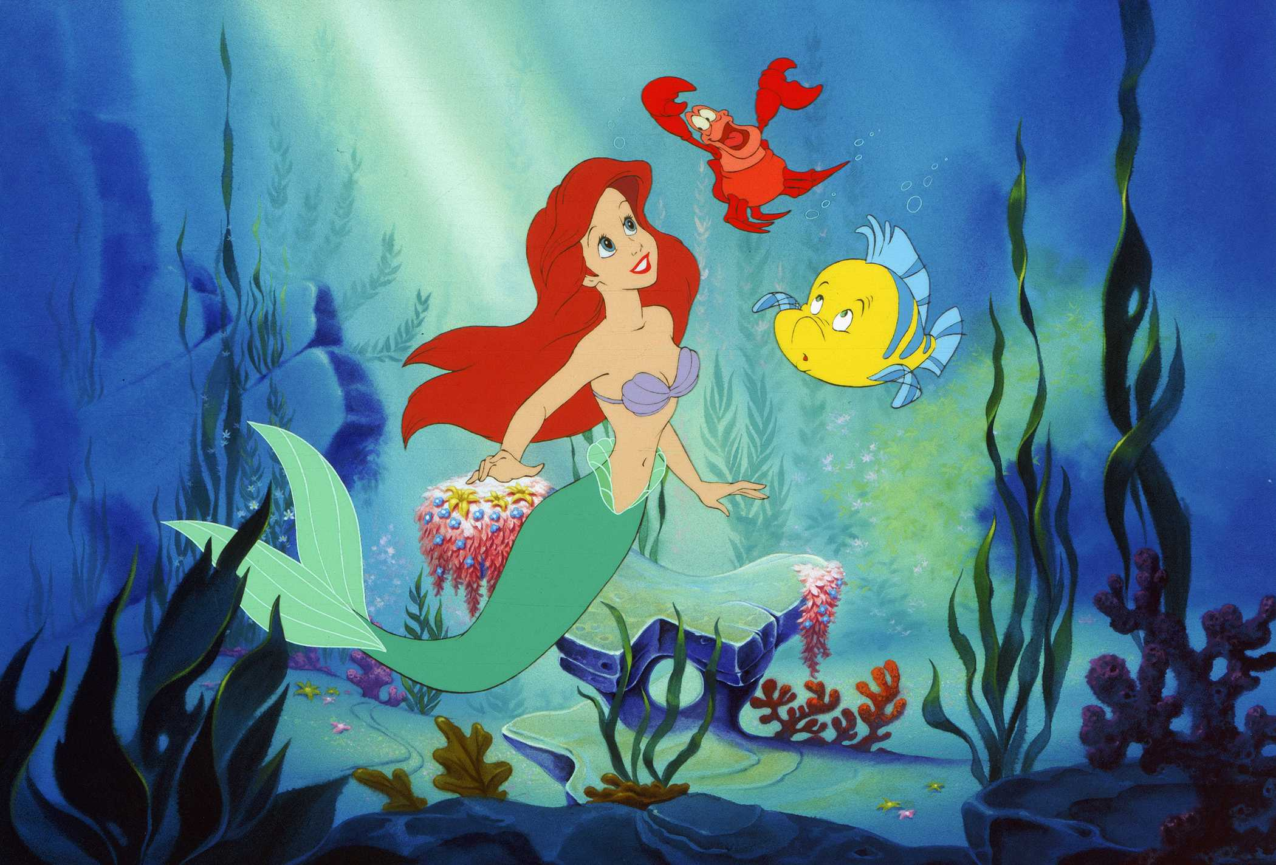
Hans Christian Andersen
Born April 1805; Died August 1875
Danish writer
Wrote some of his stories originally
Affiliated with royalty and Charles Dickens
Known for: The Littler Mermaid, Thumbelina, The Princess and the Pea

Slide 9
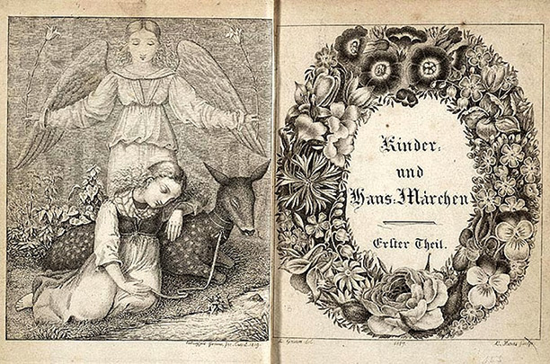
The Grimm Brothers
Frontispiece and decorative title page of an 1819 edition of the Brothers Grimm's 'Kinder-und Hausmarchen', illustrated by Ludwig Emil Grimm with engravings by L. Haas.

Slide 10
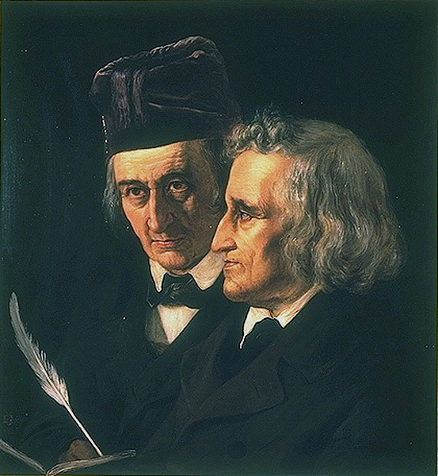
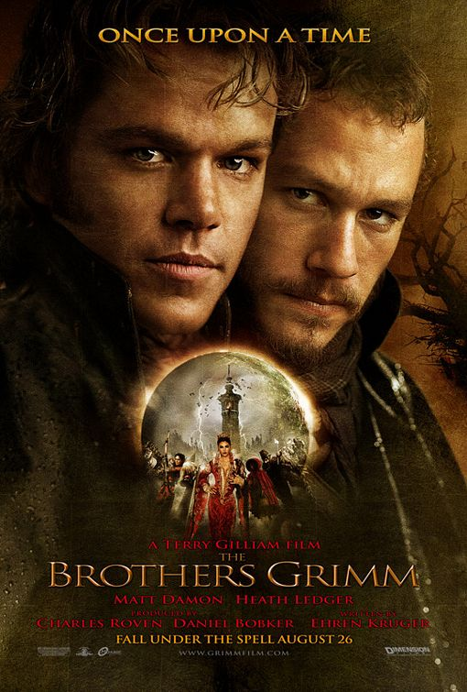
Brother’s Grimm
Jacob and Wilhelm Grimm
European tales
Grimm’s Law
Used “contamination” technique
  Look at all the variants of a story, strip them away and find the true story
Created literary versions of folktales
Known for: Cinderella, Snow White, Rapunzel, Hansel and Gretel

Slide 11
“Quotes”
Quotes represent exact language
They should be used sparingly and not be extensive in length
Generally you need a comma before the first quotation mark
Always in pairs – “Princess”
Capitalize the first letter unless the quote is a fragment
  She exclaimed, “I loved orange slices, and on a sunny day they were delicious.”
  She enjoyed orange slices and “on a sunny day they were delicious.”
If the quote is interrupted mid-sentence, do not capitalize the second part
The question mark goes inside the quote, unless the question is about the quote.
  He asked, “Do you like pizza?”
  Do you agree with Robert Frost’s “Road Not Taken”?
The period goes inside the quotations marks
  She said, “I love sushi.”

Slide 12
Quotation Marks: Find the Error/s
“Live Like there is no midnight” said Cinderella.
In Belle’s words “people think I’m odd, so I know how it feels to be different, and I know how lonely that can be”.
Peter Pan comments, “So come with me, where dreams are born, and time is never planned. Just think of happy things, and your heart will fly on wings forever, in Never Never Land.”
Walt Disney said That’s the real trouble with the world, too many people grow up. He also said Disneyland will never be completed. It will continue to grow as long as there is imagination left in the world. He said it’s kind of fun to do the impossible.

Slide 13
The Corrected Version
“Live Like there is not midnight,” said Cinderella.
In Belle’s words, “People think I’m odd. So I know how it feels to be different, and I know how lonely that can be.”
Peter Pan comments, “So come with me, where dreams are born, and time is never planned. Just think of happy things, and your heart will fly on wings forever, in Never Never Land.”
Walt Disney said, “That’s the real trouble with the world, too many people grow up.” His other popular quotes include, “Disneyland will never be completed. It will continue to grow as long as there is imagination left in the world,” and “It’s kind of fun to do the impossible.”

Slide 14
Quick Reflection
Take the next five minutes to answer these questions. One sentence for each is sufficient. This can go in your journal or with your notes.
What was your favorite fairy tale as a child?
What was it about?
What was the lesson it seemed to teach young children?
Reword the lesson as a rule for people in society.
Is this a lesson that would still be valuable for a grown-up? Explain.
Are there any archetypes in the tale? Explain.
Are there any symbols? Explain.

Slide 15
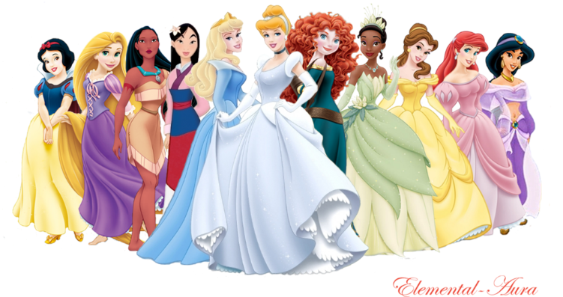
Think about the popular women in Disney movies; Snow White, Cinderella, Jasmine, etc. How are female characters typically portrayed in a fairy tale? What role do they play?
Journal #2

Slide 16
Brother’s Grimm Assignment
Pre-reading
  What is the story about? As a group give a brief W
  Think about the elements of a fairy tale we discussed yesterday
  Reading
      What is different in the Grimm version?
      Make sure you note where the story deviates from your previous views
      As a group you will present your fairy tale to the rest of the class!
      You will want to present it as a before and after
      Make sure you draw on the literary terms and you cover the ‘necessary elements’ of a fairy tale which was discussed yesterday (evil, magic, moral, female in distress, hero, symbol, environment, etc.)
      Include one quote and why your group chose it

