Slide 1
Friday’s Activity
Please place this in your notebooks

Slide 2
Imagery
In your journals:
Number 1-4
For each image write what you see
Then describe each of the sense as you would imagine them with the image (this can just be a bulleted list of what you smell, hear, touch, see, taste)

Slide 3
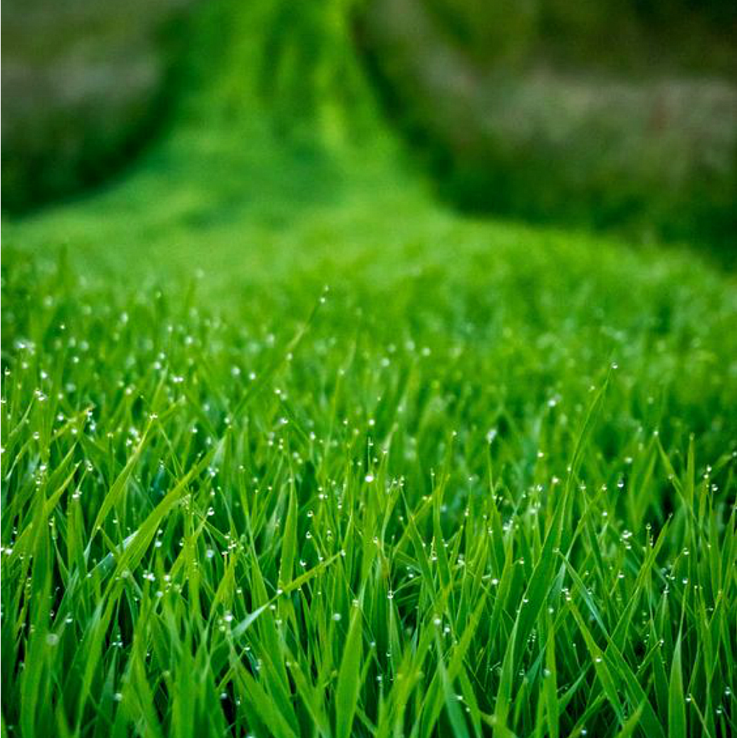
Example:
Image #1 is of a lawn
Smell: fresh cut grass
Hear: my dog barking for me to throw the ball
Taste: fresh made sweet tea
Touch: a crisp glass of sweet tea
See: a lawn mower cooling down

Slide 7
