Slide 1
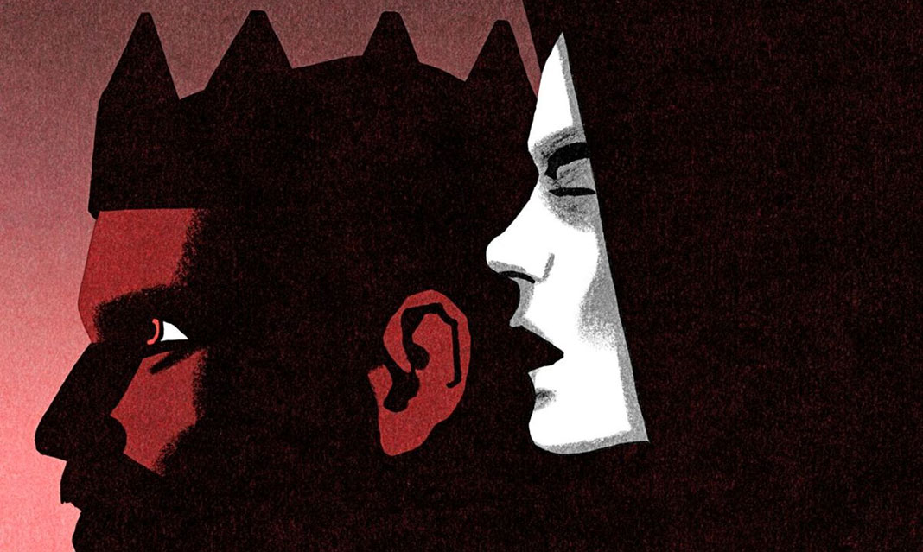
Macbeth
Witches, Treachery, Murder…Oh My

Slide 2
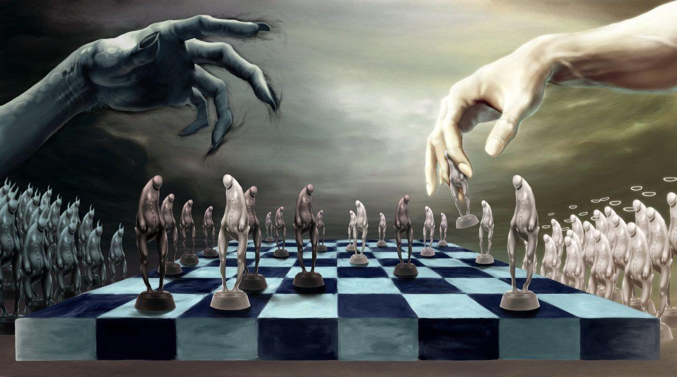
Theme
The main idea or underlying meaning of a literary work
In Macbeth
Fate v. Evil
Appearance v. Reality
The effects of guilt
Nature of Evil

Slide 3
JOUrnal
What is a tragedy? List some key elements necessary to be considered a tragedy. Examples from books or movies?

Slide 4
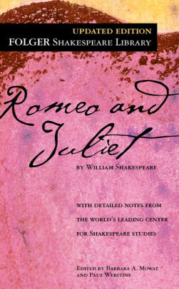

Slide 5
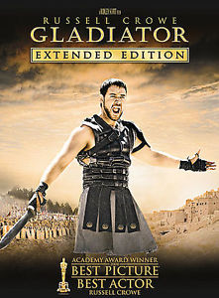
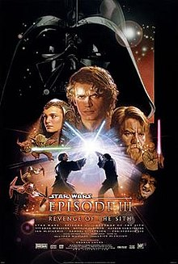

Slide 6
Tragedy
A series of unfortunate events where character(s) undergo several misfortunes which culminate in an epic disaster
5 stages
happy times
intro to problem
problem worsens to a crisis
characters are unable to prevent problem from taking over
problem results in a catastrophic, grave ending

Slide 7
Imagery
Use of figurative language to represent objects, actions, and ideas in such a way that it appeals to our physical senses
In your journals:
Number 1-4
For each image write what you see
Then describe each of the sense as you would imagine them with the image (this can just be a bulleted list of what you smell, hear, touch, see, taste)

Slide 8
Example:
Image #1 is of a lawn
Smell: fresh cut grass
Hear: my dog barking for me to throw the ball
Taste: fresh made sweet tea
Touch: a crisp glass of sweet tea
See: a lawn mower cooling down

Slide 12
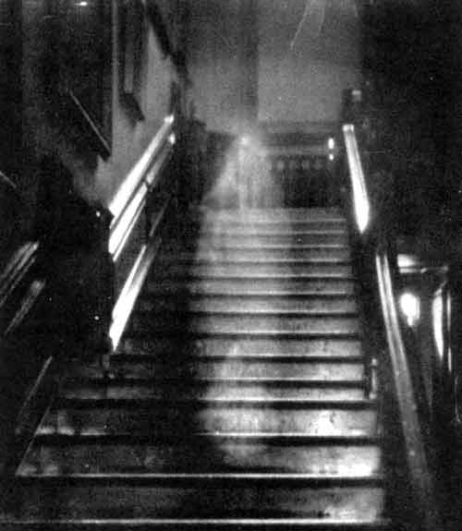

Slide 13
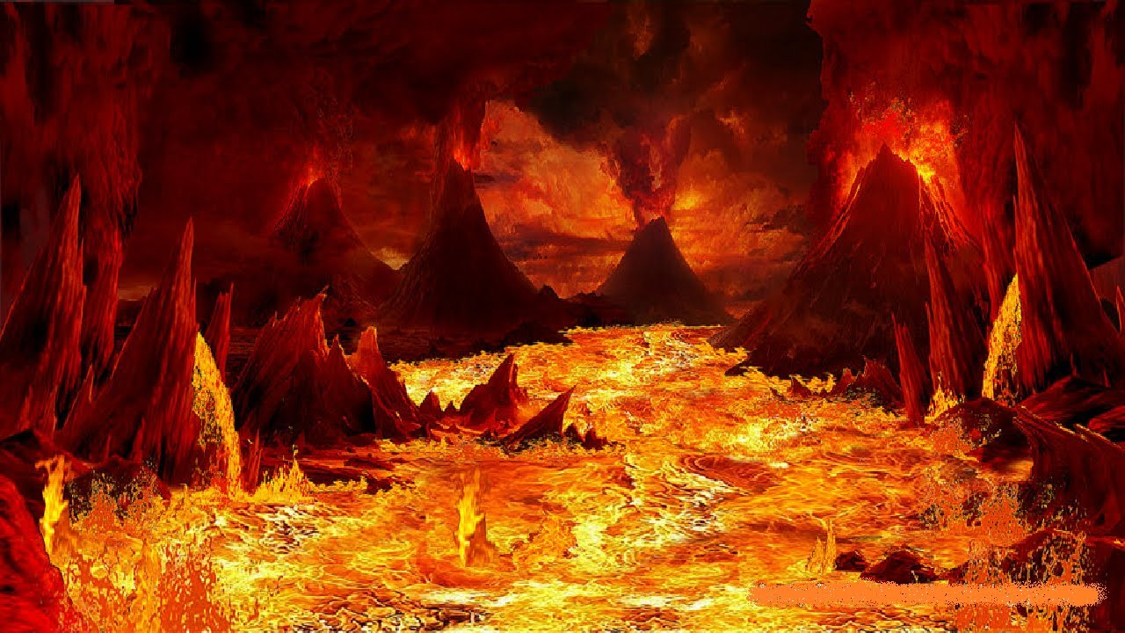
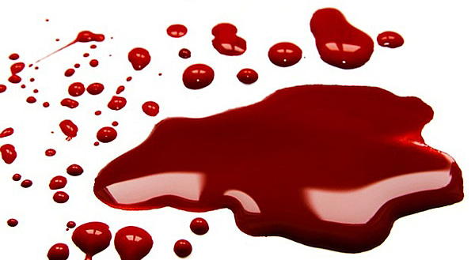
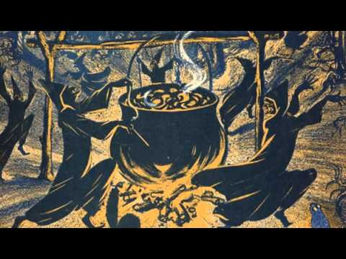
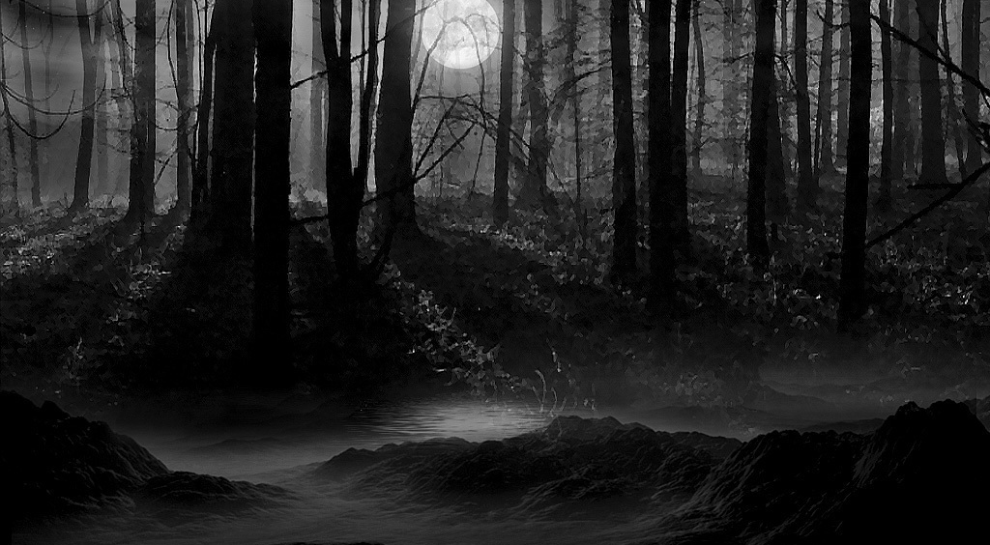
Imagery in Macbeth
Photo #3: Hell
Photo #4: Sorcery/ Paranormal
Photo #1: Blood
Photo #2: Darkness/Night

Slide 14
Act I
Chastise: to discipline or criticize severely
Prophetic (prophesy): the foretelling or prediction of what is to come
Trifle: an article or thing of very little value

Slide 15
Act II
Allegiance- loyalty or commitment to a superior, group, or cause
Quenched- satisfy thirst by drinking; extinguish (a fire)
Sacrilegious- the violent or profanation(desecration/defilement) of anything sacred or held sacred

Slide 16
Act III
Dauntless- not to be intimidated; fearless
Malice – desire to inflict injury, harm, or suffering on another out of hostile impulse or meanness
Predominant – to be stronger or leading element or force
Tyrant- a ruler who uses power oppressively or unjustly

Slide 17
Act IV
Desolate- barren or laid waste; devastated
Entrails- the intestines; internal part of anything
Pernicious- causing insidious harm or ruin; hurtful; deadly

Slide 18
Act V
Fury- wild or violent anger
Pristine – in its original condition; unspoiled
Arbitrate – determine; settle; act as the person chosen to go between two parties

